Slide 1

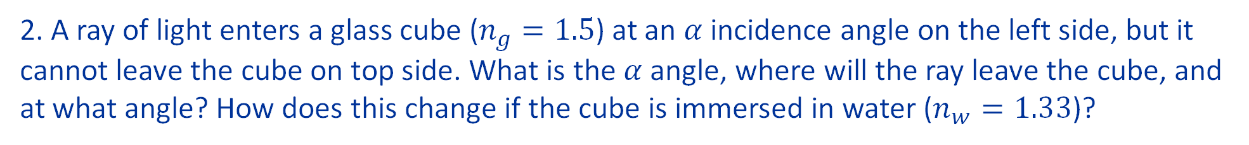

2. A ray of light enters a glass cube ($n_{g}=1.5$) at an $α$ incidence angle on the left side, but it cannot leave the cube on top side. What is the $α$ angle, where will the ray leave the cube, and at what angle? How does this change if the cube is immersed in water ($n_{w}=1.33$)?
$$α$$
$$n_{g}=1.5$$

Slide 2







2. A ray of light enters a glass cube ($n_{g}=1.5$) at an $α$ incidence angle on the left side, but it cannot leave the cube on top side. What is the $α$ angle, where will the ray leave the cube, and at what angle? How does this change if the cube is immersed in water ($n_{w}=1.33$)?
$$γ$$
$$γ$$
Snell’s law:
$n_{a}\sin{α}=n_{g}\sin{β}$
$$β$$
Total internal reflection:
$$α$$
$n_{g}\sin{γ}≥n_{a}$
$$n_{g}=1.5$$

Slide 3

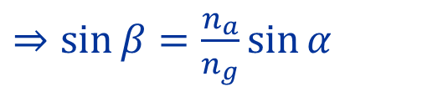





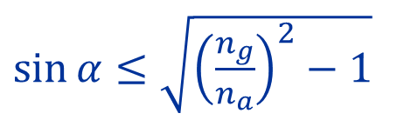


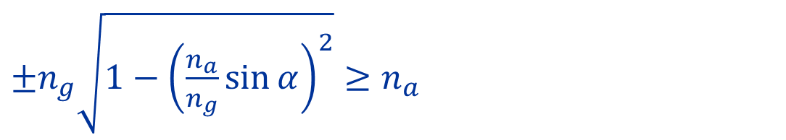
2. A ray of light enters a glass cube ($n_{g}=1.5$) at an $α$ incidence angle on the left side, but it cannot leave the cube on top side. What is the $α$ angle, where will the ray leave the cube, and at what angle? How does this change if the cube is immersed in water ($n_{w}=1.33$)?
$\left(I\right) n_{a}\sin{α}=n_{g}\sin{β}$
$⇒\sin{β}=\frac{n_{a}}{n_{g}}\sin{α}$
$$γ$$
$$γ$$
$\left(II\right) n_{g}\sin{γ}≥n_{a}$
$⇒ \sin{γ}=±\sqrt{1−\sin^{2}{β}}$
${\left(III\right) sin}^{2}{β}+\sin^{2}{γ}=1$
$$β$$
$\left(II\right) \& \left(III\right) ⇒ ±n_{g}\sqrt{1−\sin^{2}{β}}≥n_{a}$
$$α$$
$±n_{g}\sqrt{1−{\left(\frac{n_{a}}{n_{g}}\sin{α}\right)}^{2}}≥n_{a}$
$\sin{α}≤\sqrt{{\left(\frac{n_{g}}{n_{a}}\right)}^{2}−1}$
$=1.12$
$$n_{g}=1.5$$
Always true!

Slide 4



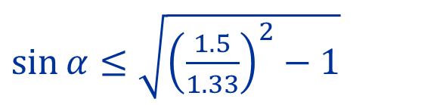
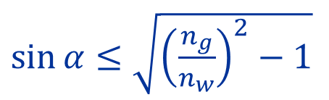


2. A ray of light enters a glass cube ($n_{g}=1.5$) at an $α$ incidence angle on the left side, but it cannot leave the cube on top side. What is the $α$ angle, where will the ray leave the cube, and at what angle? How does this change if the cube is immersed in water ($n_{w}=1.33$)?
$$γ$$
$$γ$$
$$β$$
$\sin{α}≤\sqrt{{\left(\frac{n_{g}}{n_{w}}\right)}^{2}−1}$
$$α$$
$$β$$
$\sin{α}≤\sqrt{{\left(\frac{1.5}{1.33}\right)}^{2}−1}$
$$α$$
$\sin{α}≤0.272$
$α≤15.78°$
$$n_{g}=1.5$$
$$n_{w}=1.33$$

Slide 5
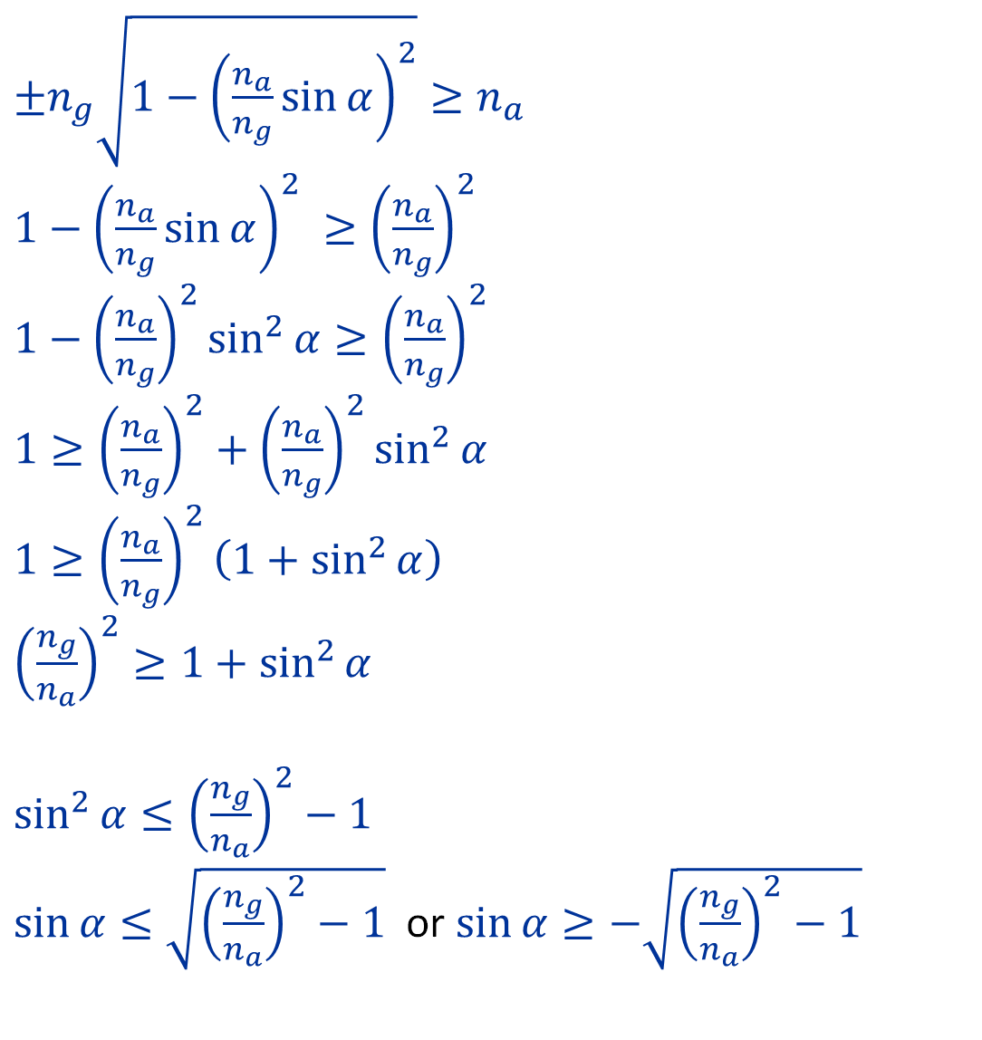
$±n_{g}\sqrt{1−{\left(\frac{n_{a}}{n_{g}}\sin{α}\right)}^{2}}≥n_{a}$
$1−{\left(\frac{n_{a}}{n_{g}}\sin{α}\right)}^{2} ≥{\left(\frac{n_{a}}{n_{g}}\right)}^{2}$
$1−{\left(\frac{n_{a}}{n_{g}}\right)}^{2}\sin^{2}{α}≥{\left(\frac{n_{a}}{n_{g}}\right)}^{2}$
$1≥{\left(\frac{n_{a}}{n_{g}}\right)}^{2}+{\left(\frac{n_{a}}{n_{g}}\right)}^{2}\sin^{2}{α}$
$1≥{\left(\frac{n_{a}}{n_{g}}\right)}^{2}\left(1+\sin^{2}{α}\right)$
${\left(\frac{n_{g}}{n_{a}}\right)}^{2}≥1+\sin^{2}{α}$
$\sin^{2}{α}≤{\left(\frac{n_{g}}{n_{a}}\right)}^{2}−1$
$\sin{α}≤\sqrt{{\left(\frac{n_{g}}{n_{a}}\right)}^{2}−1}$ or $\sin{α}≥−\sqrt{{\left(\frac{n_{g}}{n_{a}}\right)}^{2}−1}$

